Slide 1
Reinforcement & Team Agreement
May 2024
Notes:
Please use this cover when there is an image in the background.

Slide 2
AGENDA
Why Agile?
Ceremonies
Values
Principles
Team Agreement Matrix

Slide 3
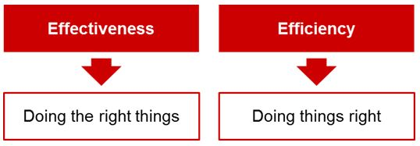

Slide 4
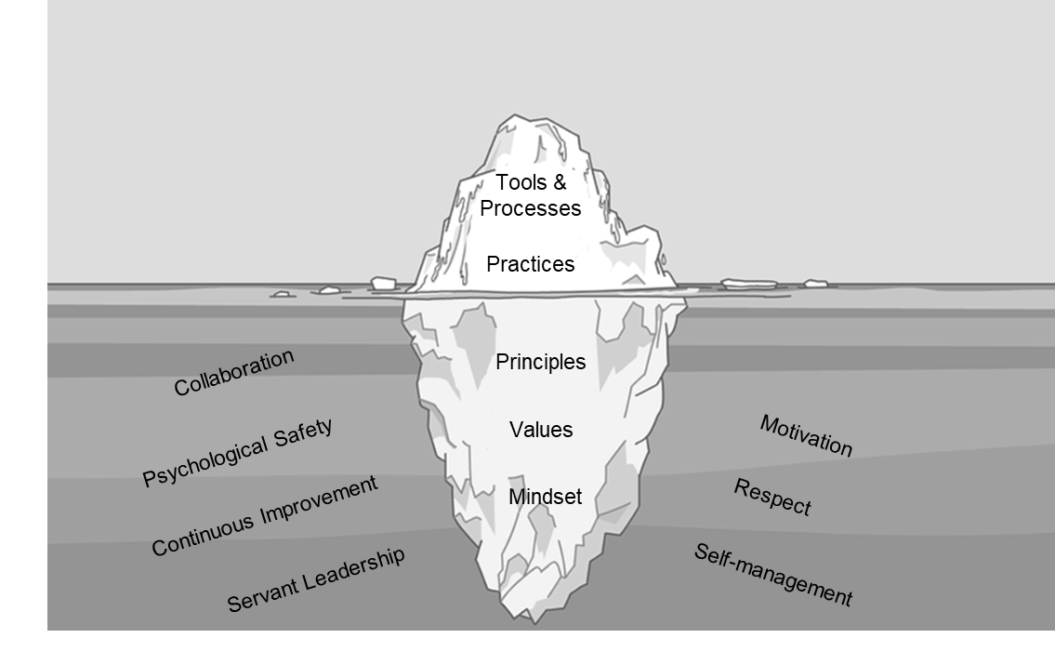
Agile Iceberg
Doing
Agile
Being
Agile

Slide 5
Focus on our Customer
Organise ourselves as Customer journeys
Plan lean & Empiricism
Empower our people
Why Agile?

Slide 6
Agile requires a mindset shift
Promote values & behaviors

Slide 7

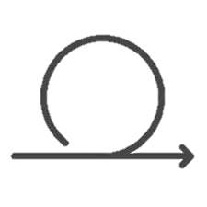

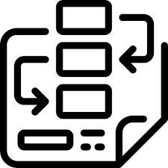
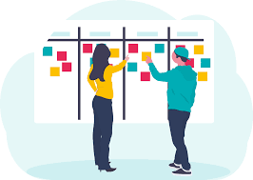



Agile Ceremonies / Events for Technical Squads
1
2
An iteration is a period of time which the team demarks to deliver an amount of work.
It can be between 1 to 4 weeks.
2 weeks is usually adopted by most MCB teams who are working in Scrum / Scrumban.
An iteration can be referred as a sprint when using the Scrum / Scrumban framework.
The iteration is the container of all the Agile ceremonies.
(Iteration does not apply to teams working in Kanban. Such team does not have predefined iterations.)
The backlog refinement / grooming represents the session in which the team prepares items in advance of upcoming planning for future iterations. Usually, teams prepare work for around 1 to 3 iterations.
Preliminary work is done by the Product Owner / Service Owner / Person responsible of the product / service, the Business Analyst, the architects, the tech lead, the designer (referred to as the Amigos / Triad).
The engineers are looped for refinement when the Amigos / Triad feel ready, so as to maintain proper balance between the work targeted during the iteration v/s the preparation for upcoming iterations.
Output / Outcome:
Prioritized backlog, with user stories and tasks for 1 to 3 iterations ahead
Estimated user stories for the next iteration
Shared clear understanding, by the whole team, for user stories for the next iteration
Users stories and tasks no more relevant are removed
The planning represents the session in which the team confirms the work which will be targeted for completion during the iteration.
The priorities are discussed and agreed.
(Planning session is also practiced by teams working in Kanban. The Kanban team plan according to the goal they will target.)
During planning, the WHY, WHAT and HOW for the iteration / goal are discussed. It is recommended that the team considers only user stories meeting the team’s Definition of Ready (DoR) for the iteration.
WHY is the Iteration Valuable?
The Product Owner / Service Owner / Person responsible of the product / service clarifies the intended value being expected out of the iteration.
WHAT can be done in the Iteration?
The team selects items from the product backlog into the iteration backlog based on the
Capacity for the iteration.
Alignment to the goals of the iteration.
Alignment with the priority established by the Product Owner / Service Owner / Person responsible of the product / service.
HOW will the chosen work get done?
For each item, the team plans the work necessary to create an increment, which aligns with the team's Definition of Done (DoD).
Outcome:
Team commits to achieve the goal of the iteration (users stories and tasks).
Frequency
Duration
Participants
Ongoing during an iteration
Around 10% of the team capacity in an iteration
Full team
Once per iteration. The end of the planning officialises the start of the iteration.
30 mins to 1 hour (Proper refinement helps reduce the time required here)
Full team.
7

Slide 8


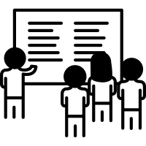
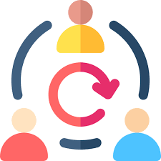
Agile Ceremonies / Events for Technical Squads
3
4
5
The showcase / review / demo represents the session during which the team shows to stakeholders, sponsors and all persons interested in the product / service, the increment produced by the team during the iteration and which matches the team’s Definition of Done (DoD).
It is also a platform which the team can use to
briefly raise issues / blockers / risks for which they will be soliciting support.
cover other deliverables of the iteration (e.g. designs, prototypes, …)
This session reduces the need for stakeholders and other actors to disturb the team for updates during the iteration.
The team gathers feedback from sponsors / stakeholders. The feedback will be factored on-board in the upcoming planning.
The retrospective represents the session in which the team takes time to take stock of the strengths and areas of improvement which the team needs to address for a recent period of time, typically from the ending iteration.
The team can build up on the strengths for upcoming iterations.
The discussion on the areas of improvement is action oriented / identify experiments / aimed at continuous improvement.
Examples of items to be discussed in retrospective
Burndown
Not meeting goals of the iteration and work to be carried forward
Delays
Output / Outcome:
Actions with respective owners and timeframe for areas of improvement
The stand-up represents the session which is conducted by the team to self-organize to tackle the work (mini-planning activity), aligned with the prioritized activities so as to achieve the team's goals.
The stand-up is performed by the team and for the team - not a status / report meeting.
It is usually scheduled to happen same place, time and at a pre-defined frequency to reduce complexity around availability of team members.
Output / Outcome:
The blockers / slowers / issues are discussed and a plan made to address these at earliest convenience so as to enable the team to continue the progress.
Focus around getting the planned work to Done.
Frequency
Duration
Participants
Once per iteration
Usually 30 minutes
Full team and invitees
Once per iteration. Demarks end of the iteration
1 hour
Full team
Usually daily
15 minutes
Full team
8

Slide 9

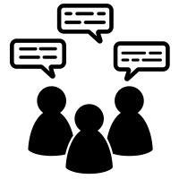
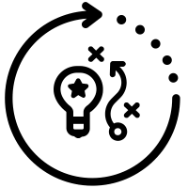
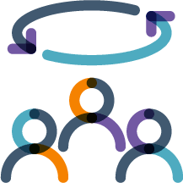
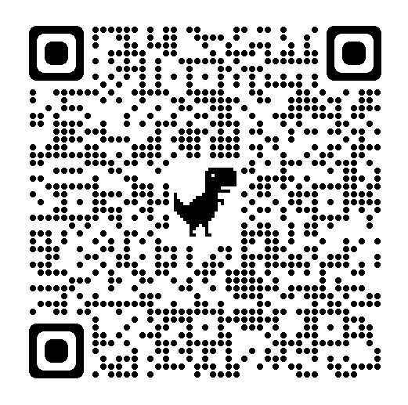
Agile Ceremonies / Events for Technical Squads
I
II
During release planning, the team identifies a subset of functionality from the product roadmap, which can be delivered in the upcoming release and how long it will take to develop that functionality.
The output of this activity is an excellent tool to communicate with other teams at MCB, especially for the cross-dependencies and for support required.
Approach
[More details in Estimation & Planning guidelines (Part 1)​]
Define the goal for the release
Review and prioritize the tasks / user stories from the backlog pertaining to the release
Estimate the work
Map the release to sprints
The release retrospective represents the session in which the team and other actors who directly contributed to the release takes time to take stock of their strengths identified to make happen the release and areas of improvement which need to be addressed.
The team can build up on the strengths for upcoming releases.
The discussion on the areas of improvement is action oriented / identify experiments / aimed at continuous improvement.
The ceremonies / events are investments, intended to:
Plan, track and engage with stakeholders to smoothen the delivery of work
Understand the details of the work being executed
Improve collaboration and communication among the team members
As an example, for a typical sprint of 2 weeks. With practice, teams handle the Must Have ceremonies within 10% to 15% of their time.
The ceremonies help in shielding the team from ad-hoc discussions / meetings during the development.
Frequency
Duration
Participants
Monthly
2 hours
Amigos / Triad
(Engineers are consulted)
Once, after the release
1 hour
Representatives of the different teams involved to make the release happen, stakeholders and sponsors.
9

Slide 10
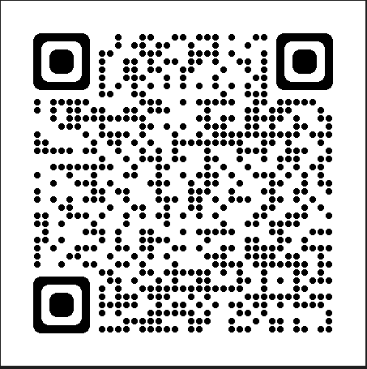
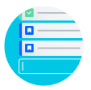

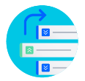
Few reminders
Watch refresher video
Agile product ownership in a nutshell
Key artifacts
A
C
Product Backlog
is the ordered list of what is needed to improve the product.
Items of the product backlog [referred to as Product Backlog Items (PBI)] represent the work, broken down as user stories or tasks, as small as possible to minimize complexity.
PBI are created so that their completion can be achieved without being dependent on other user stories.
PBI should have acceptance criteria.
Backlog refinement is the act of breaking down and further defining PBI into smaller more precise items.
Commitment: Product Goal
PBI are created to realize the Product Goal.
Product Goal represents the targeted future state of the product.
Product Increment
is a concrete stepping stone towards the Product Goal.
It represents the usable aggregation of the work done in the iteration cumulated over previous increments.
Work cannot be considered part of an Increment unless it meets the Definition of Done (DOD).
The DOD encompasses the required standards (quality, reliability, performance, etc) to ensure the healthy state of an increment.
The product increment is usually demoed in the review / showcase / demo.
Commitment: Definition of Done (DOD)
Work achieved satisfies the team’s DOD.
B
Iteration / Sprint Backlog
is a subset of the product backlog.
Represents the work being committed by the team for completion within the iteration.
Represents an actionable plan to execute the work being committed.
Is updated real-time with the team’s progress.
Is a key reference tool during stand-ups.
Commitment: Iteration / Sprint Goal
Goal representing how will the product be improved after the iteration.
Definition of Ready (DOR) enforces as minimum that user stories and tasks
Clearly define the work which has to be done.
Include clear statement of business value; helpful when prioritizing
Include any required specifications, designs, wire frames, etc.
User stories meet the INVEST criteria.
Free from external dependencies.
Definition of Done (DOD) enforces as minimum that user stories and tasks are considered completed / DONE when
The acceptance criteria are satisfied.
Releasable. Item could be shipped to a customer.
Release notes are ready.
Team Working Agreement
outlines the expectations, roles, and responsibilities of a team.
It is usually created collaboratively and agreed upon by all team members.

Slide 11
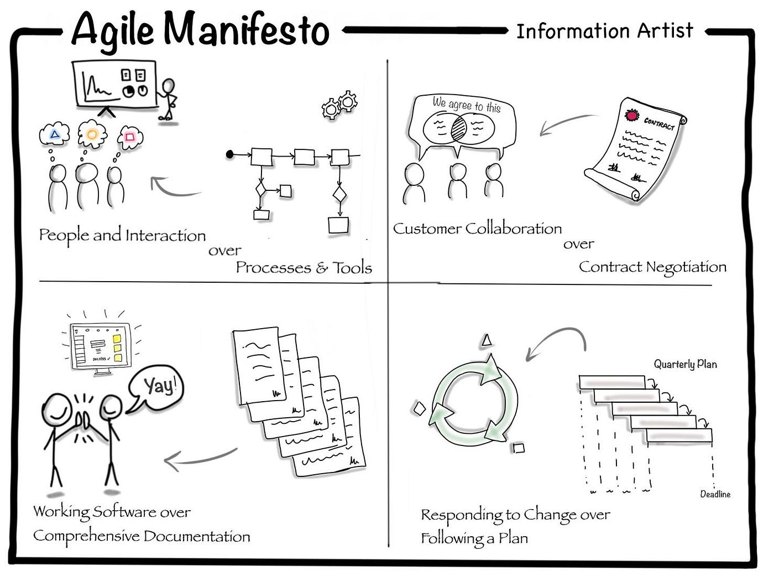

Slide 12
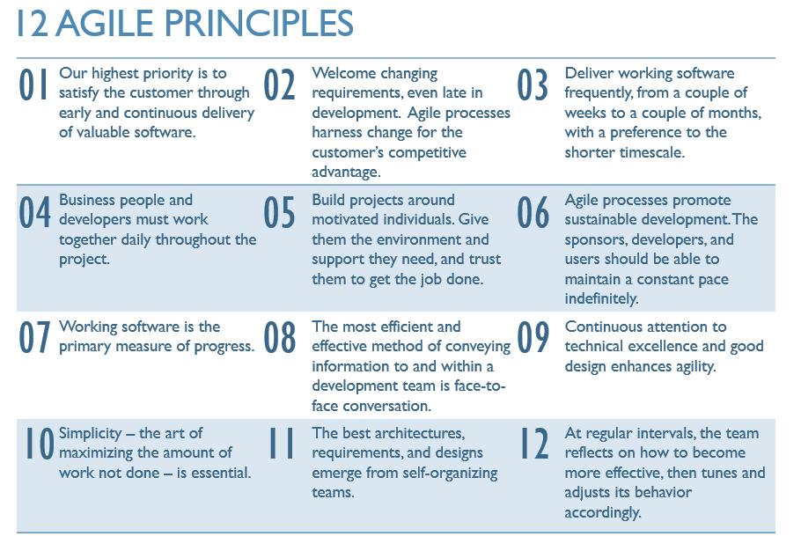

Slide 13
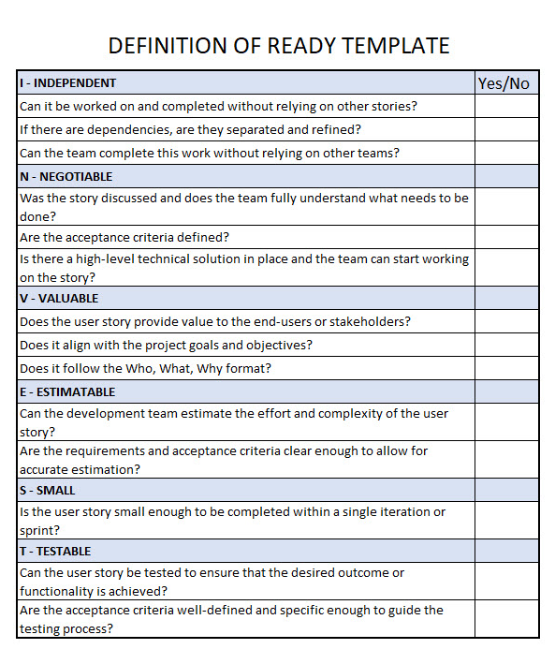
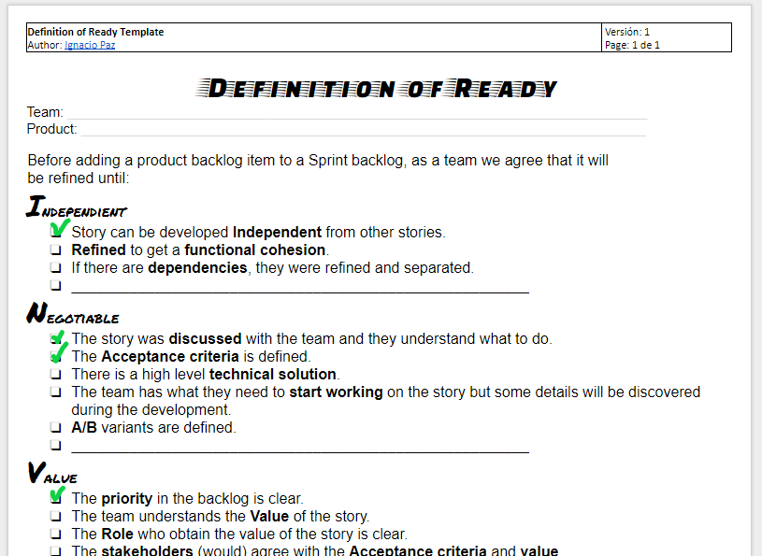
Example

Slide 14
Definition of READY

Slide 15
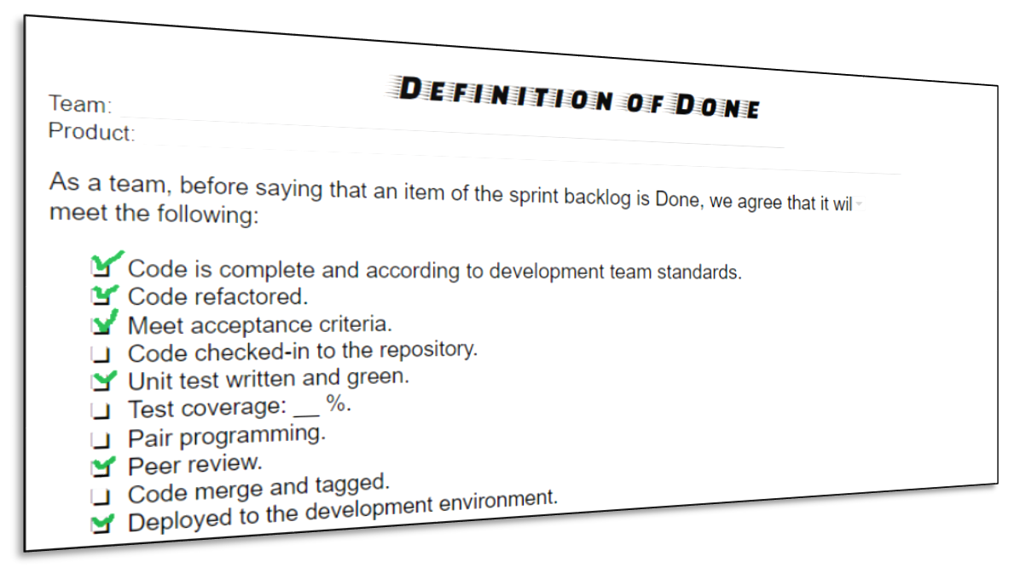
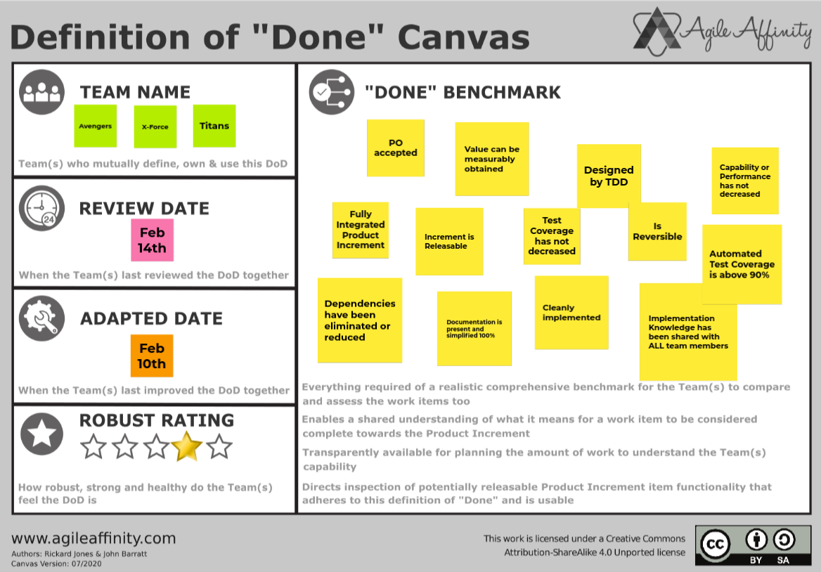
Example

Slide 16
Definition of DONE

Slide 17
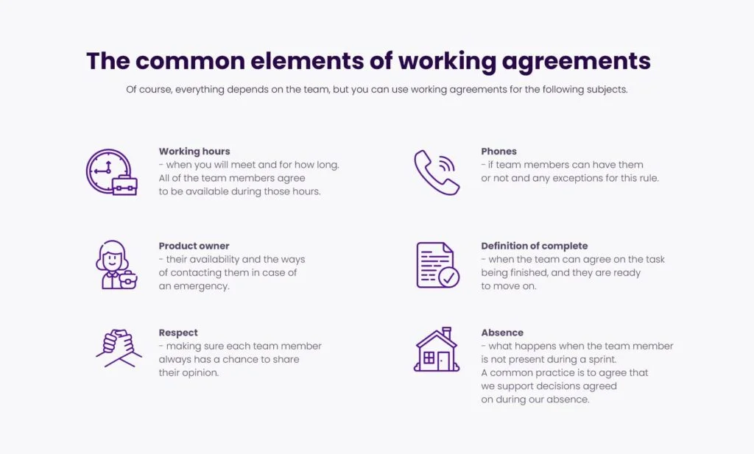
Example

Slide 18
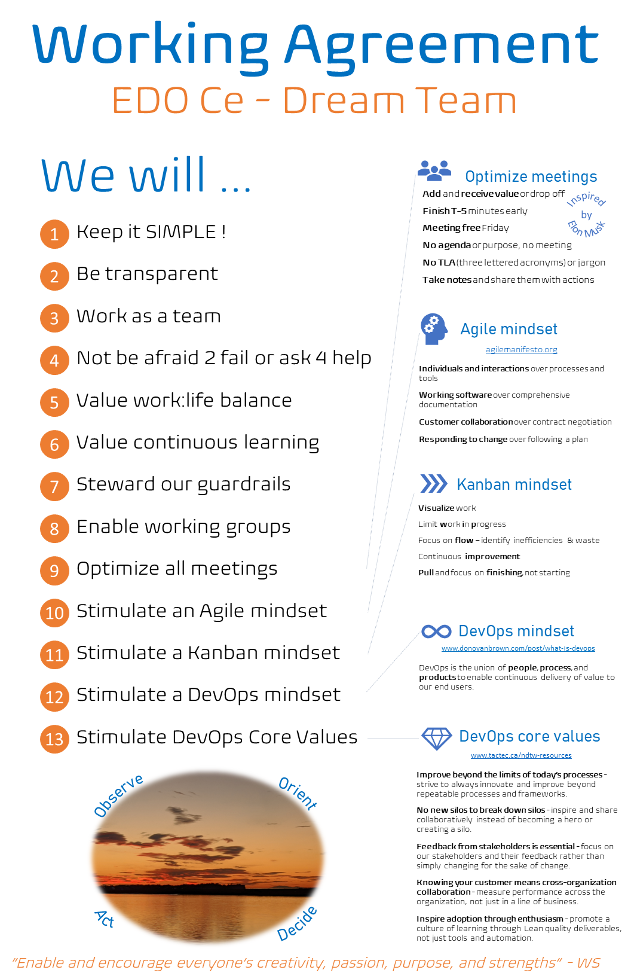
Example

Slide 19
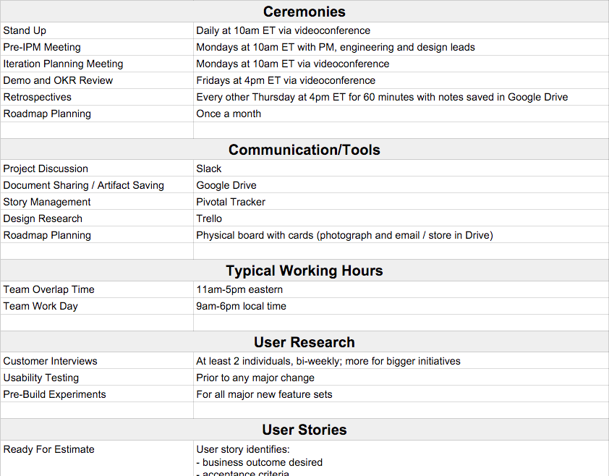
Example

Slide 20
Our team desired behaviours
As a team
 | Product Owner | Business Analyst | UX Designer | QA
Tech Lead
Engineers

